Slide 1
Exploring the Association between Debt Ratio and Economic Development: A Developing Country Level Study
Team: COGNOS
Apr. 16, 2018
Yichen Pan, Quanxu Pang, Zihao Wang, Haojunzhi Yu, Junyi Huang

Slide 2
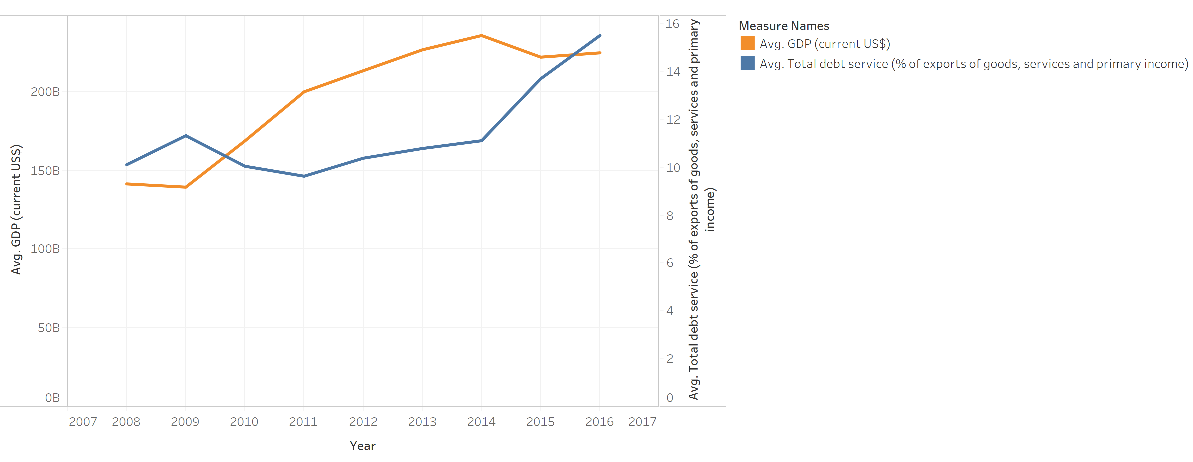
Figure 1: Avg. GDP and Avg. Total Debt Service Relationship (by Junyi Huang)
Avg. GDP and Avg. Total Debt Service Trend Line of all research countries.
In general there is positive association between Avg. GDP and Avg. Total Debt Service except some incidental year of financial crisis.
Countries could maintain a proper Total Debt Service to help the growth of the GDP.

Slide 3
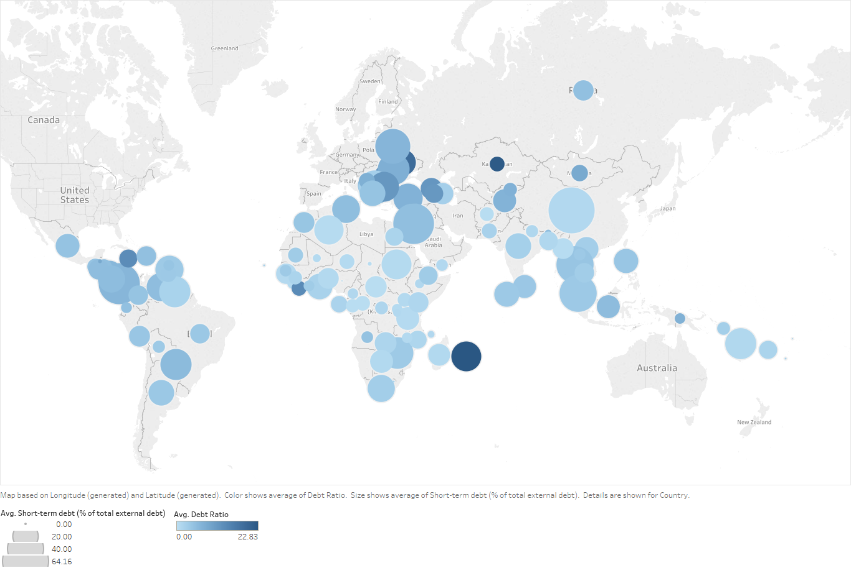
Figure 2: Average Debt Ratio and Short-term Debt percentage of each service countries (by Quanxu Pang )
This chart shows a general geological map consisting of countries with their Short-term Debt percentage and Average Debt Ratio.
Basically from the chart, countries with higher Debt Ratio seems to have higher Short-term Debt ratio.
Implications from the insight would be that countries with higher Short-term Debt ratio but with obvious lower Average Debt Ratio have better economic developments.

Slide 4
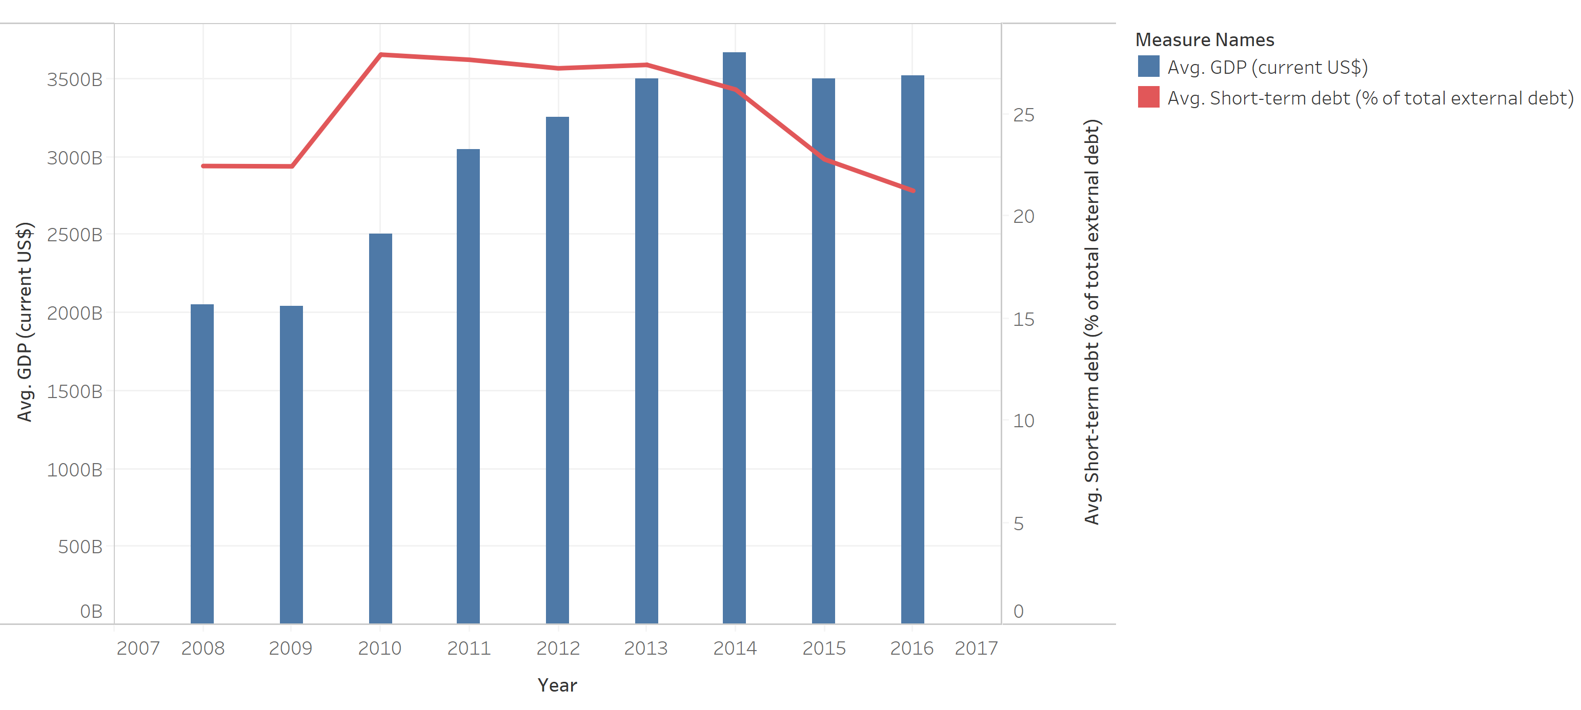
Figure 3: Avg. GDP and Avg. Short-term Debt Relationship (by Junyi Huang)
Avg. GDP and Avg. Short-term debt trend line and bar chart of all research countries
In general, there is a negative correlation between Avg. GDP and Avg. Short-term debt except few years after 2008 subprime crisis.
Countries could maintain a proper balance of short-term debt according to the previous tend of GDP to help the growth of economic development.

Slide 5
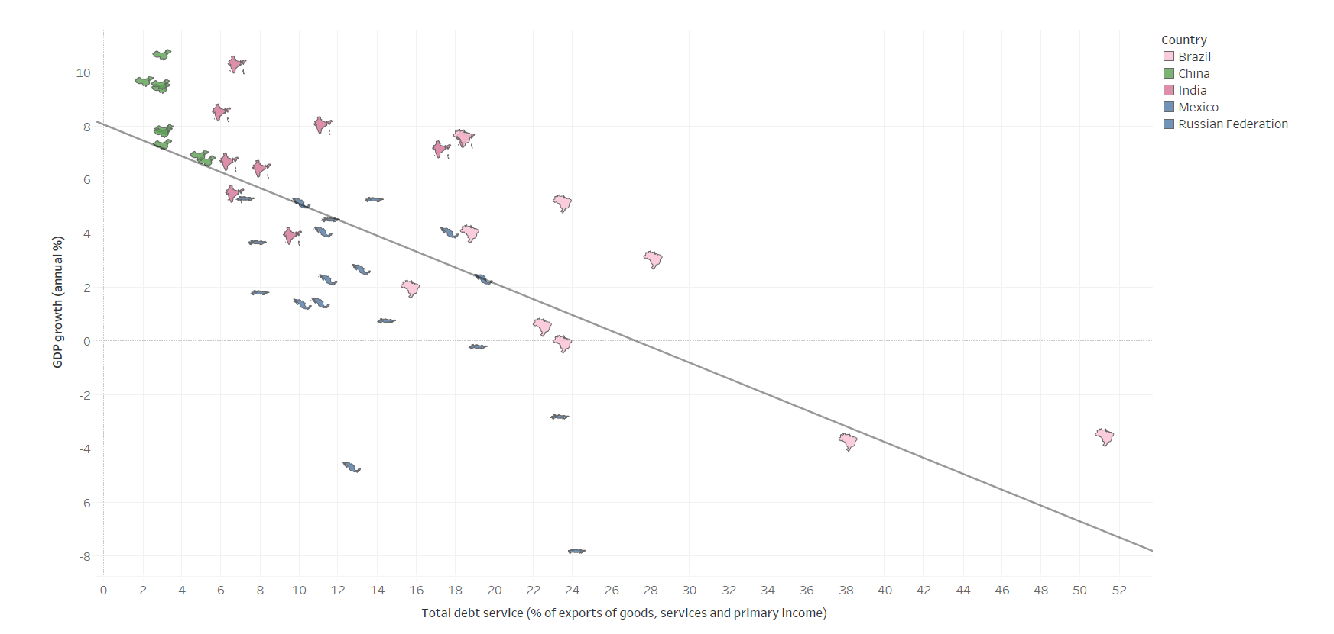
Figure 4: The correlation between GDP growth rate% and total debt service% of exports of good, service and primary income, for developing country whose GDP higher than $1000billion (By Yichen Pan)
Counties with Gross Domestic Product more than 1000 billion dollars are large economic entities in the world.
Although China, India, Brazil, Russian Federation and Mexico are developing countries, they have a huge impact all over the world.
The scatter plot and trend line in this chart implicates there is a prominent negative relation between and total debt service% and GDP growth rate.
Developing countries, which already have good economic foundations should keep a low debt% to stimulate their economic development.

Slide 6
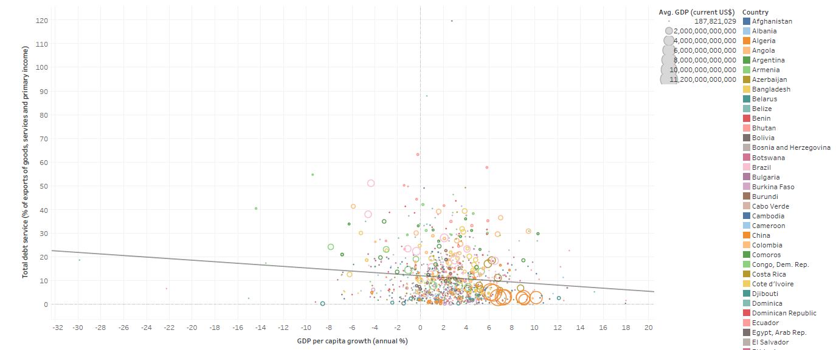
Figure 5: The correlation between GDP growth rate% and total debt service% of exports of good, service and primary income, for developing countries whose GDP is less than $1000 billion (By Yichen Pan)
Most developing counties’ Gross Domestic Product is less than 1000 billion dollars.
The scatter plot and trend line in this chart implicates there is a slightly negative relation between and total debt service% and GDP growth rate.
Developing countries, which don’t have solid economic foundations also need to concern about their debt%. They should make economic decisions based on their situations and industry structures.

Slide 7
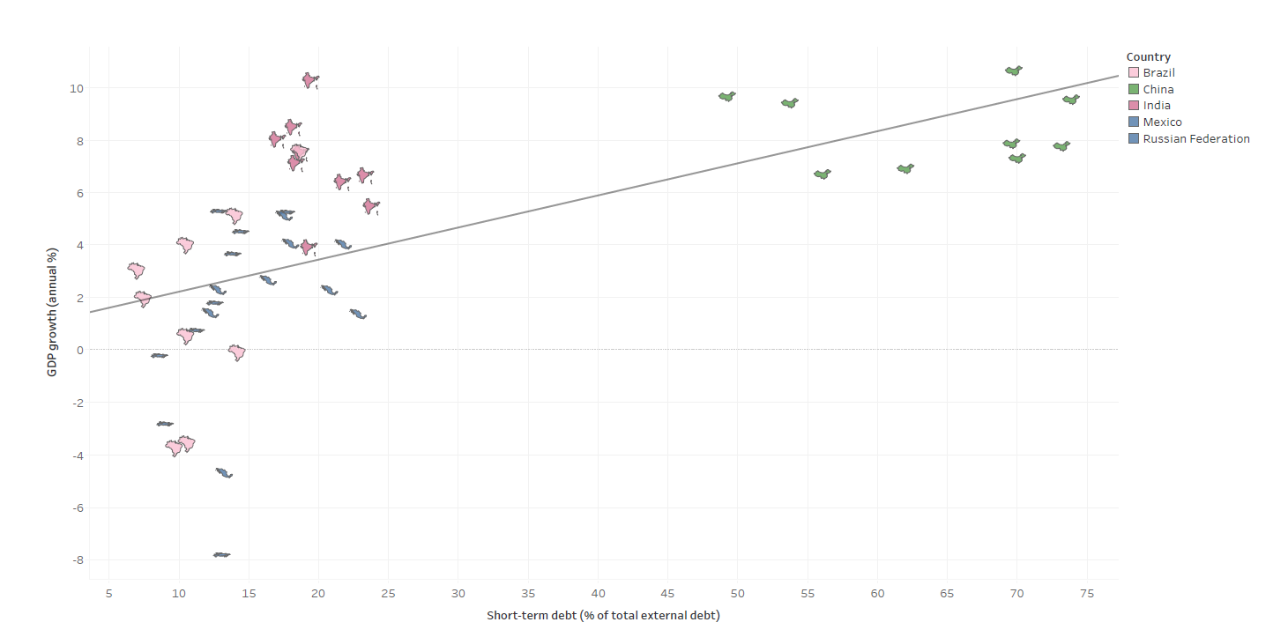
Figure 6: The correlation between GDP growth rate and Short-term debt% of total external debt for developing countries whose GDP is higher than $1000 billion (by Yichen Pan)
The scatter plot and trend line in this chart implicates there is a prominent positive relation between Short-term debt % of total external debt and GDP growth rate.
The higher Short-term debt %, the less Long-term debt a country has. For developing countries whose GDP is vast, they should focus on decrease their external debt especially long-term debt.

Slide 8
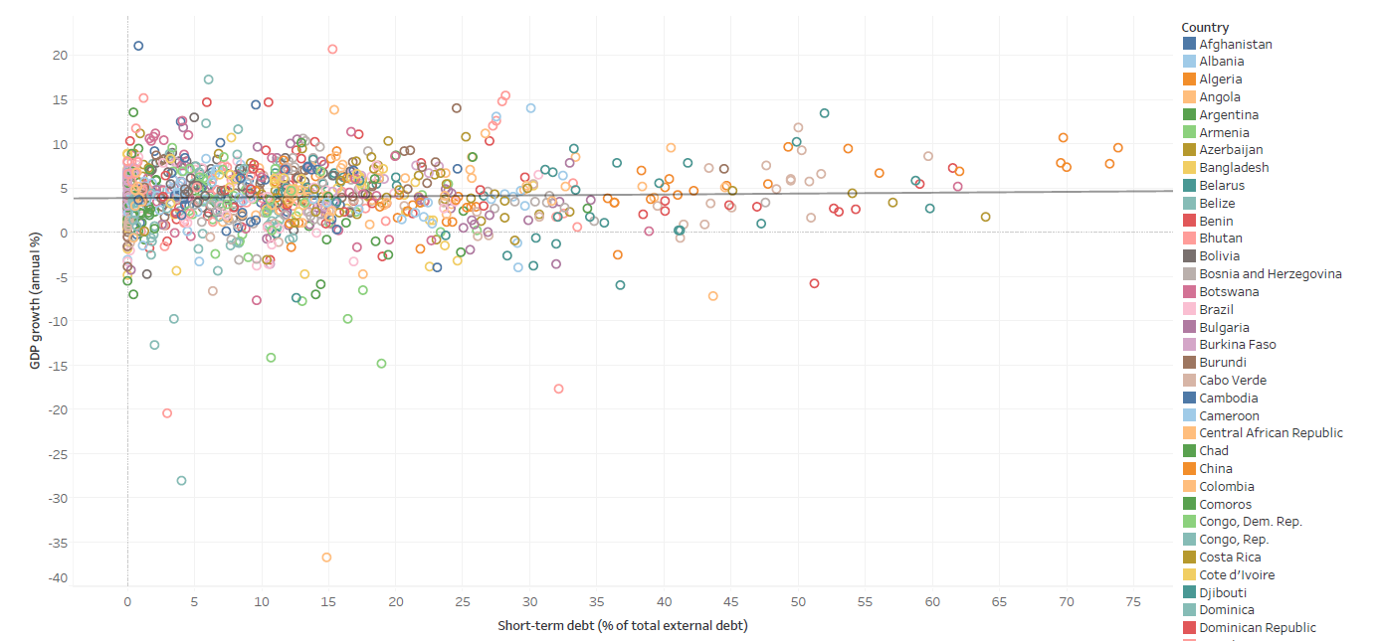
Figure 7: The correlation between GDP growth rate and Short-term debt % of total external debt for developing country whose GDP is higher than $1000 billion (by Yichen Pan)
Plots spread around trend line evenly.
The intercept of the trend line is 3.98% which is the mean of GDP growth rate for all countries whose GDP is less than $1000 billion.
Short-term debt% doesn’t have a visible effect on economic growth of developing countries whose GDP is under 1000 billion dollars.
They should try some other ways to improve their economy and don’t need to consider much on Short-term debt%

Slide 9
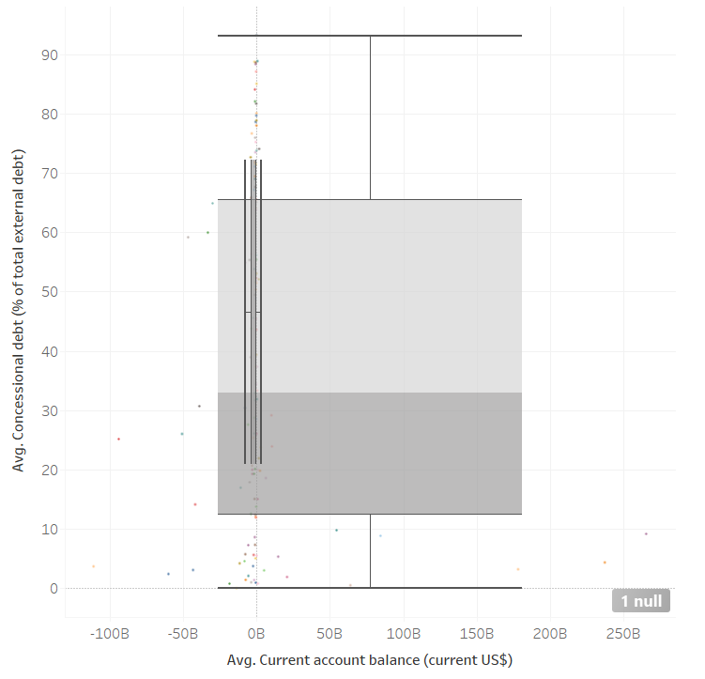
Figure 8: Boxplot of current account balance and concessional debt from countries (by Quanxu Pang)
The plot shows range and median of all of countries’ average Current Account Balance and average Concessional Debt between 2008 and 2016.
Countries have various distribution on Concessional Debt but have similar pattern on Current Account Balance (below or close to 0).
There is no relationship between Concessional Debt and Current Account Balance. In addition, China should be separated from other developing counties.

Slide 10
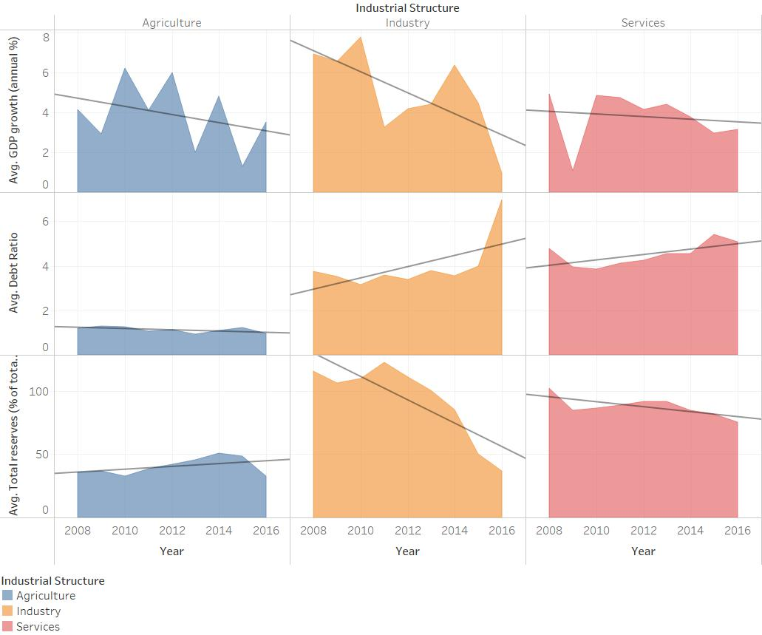
Figure 9: Variation of GDP growth rate, Debt ratio, and Total reserves in different industries (by Haojunzhi Yu)
The chart shows the Avg GDP growth rate, Avg Debt Ratio, and Avg Total reserves from each industry within 9 years.
Different relationship between GDP growth and Debt Ratio (Total reserves) in Agriculture and other two industries.
Development pattern in agriculture countries is different from other 2 types. Development of industrial countries are easier to be influenced by Debt ratio and Total reserves.

Slide 11
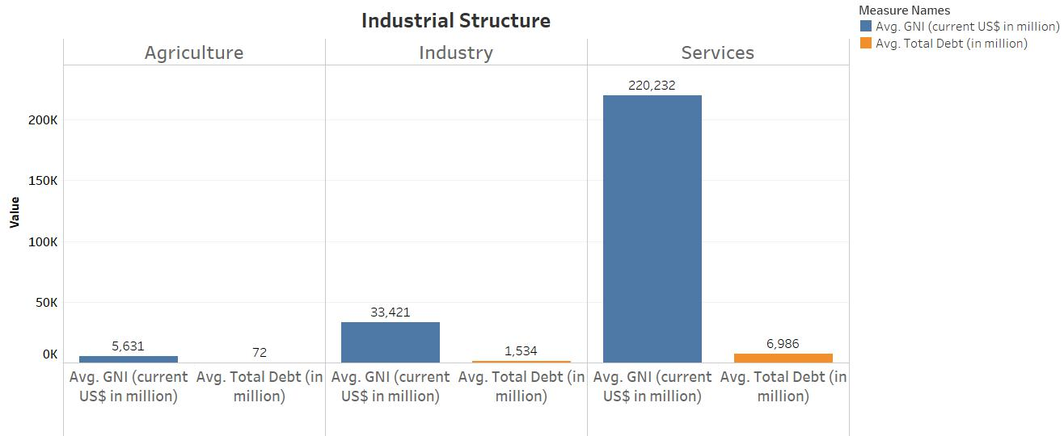
Figure 10: Relationship between average total debt and average GNI (by Zihao Wang)
The bar chart shows the comparison of average total debt and average GNI of countries in different industrial structures: primary, second and tertiary industry sector.
The countries in tertiary industrial sector have highest gross national income and relatively high total debt as well.
The countries with relatively high GNI tend to have great debt-paying ability. Thus, for economies of scale reasons, they are likely to have high debt.

Slide 12
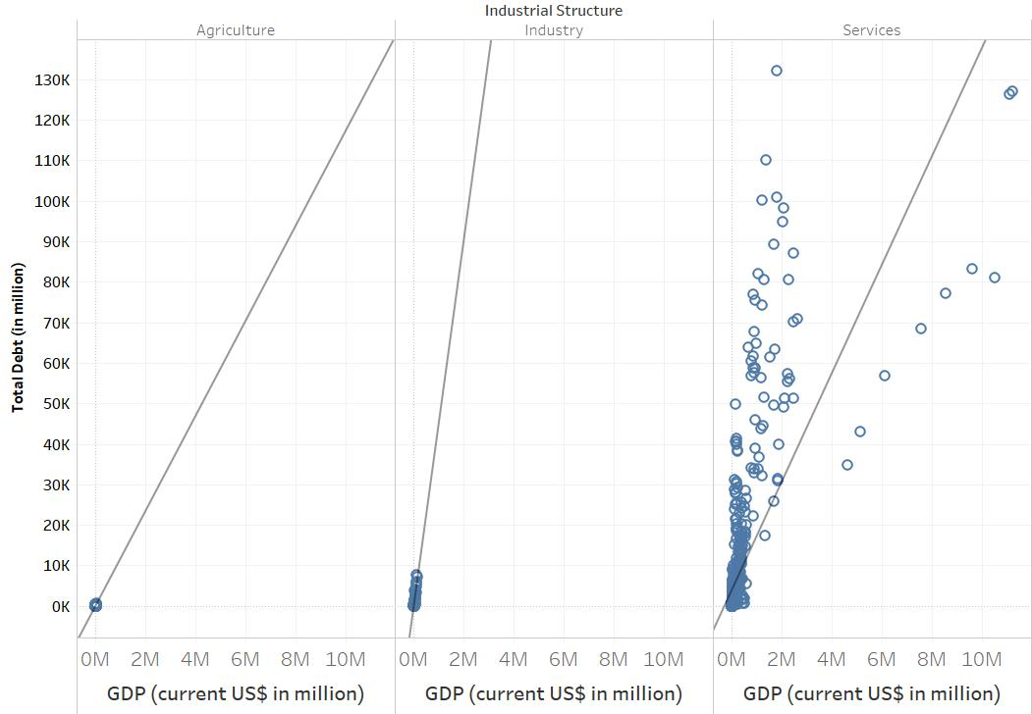
Figure 11: Relationship between total debt and GDP (by Zihao Wang)
The scatter plot shows the trend of debt-to-GDP ratios of countries in different industrial structures.
It can be seen from the slopes that the countries in second industrial sector have highest debt-to-GDP ratio while the countries in primary industrial sector have the lowest debt-to-GDP ratio.
The countries need to maintain a certain amount of liquid assets to deal with debts, while the industries in countries in secondary industry sector are asset-intensive and most of them are immovable properties.

Slide 13
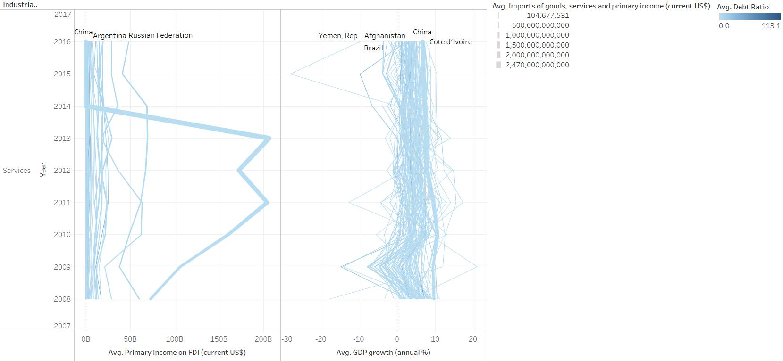
Figure 12 Variation of GDP growth and Primary income on FDI in Service industry (by Haojunzhi Yu)
The line chart shows variation of each service countries’ Primary income on FDI and GDP growth from 2008 to 2016.
Most of countries maintain stable GDP growth within 9 years except Yemen, Zimbabwe, and Ukraine. Exclude high GDP countries, other services countries have relatively low Primary income on FDI.
There is not so much relationship between GDP growth and Primary income on FDI. GDP volume can be a factor to affect Primary income on FDI.

Slide 14
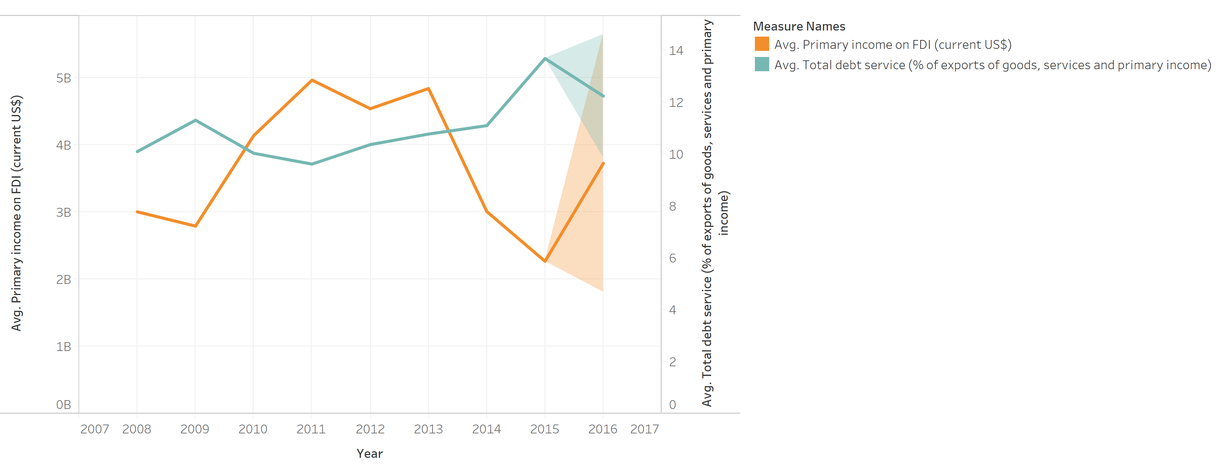
Figure 13: Avg. Primary Income on FDI and Avg. Total Debt Service Relationship and 2016 Forecasting (by Junyi Huang)
Avg. Primary Income on FDI and Avg. Total debt service trend and forecasting chart.
There is a negative correlation between Avg. Primary Income on FDI and Avg. Total debt service.
When countries’ Primary income on FDI is not high enough, countries could increase total debt service to help the growth of economic development

Slide 15
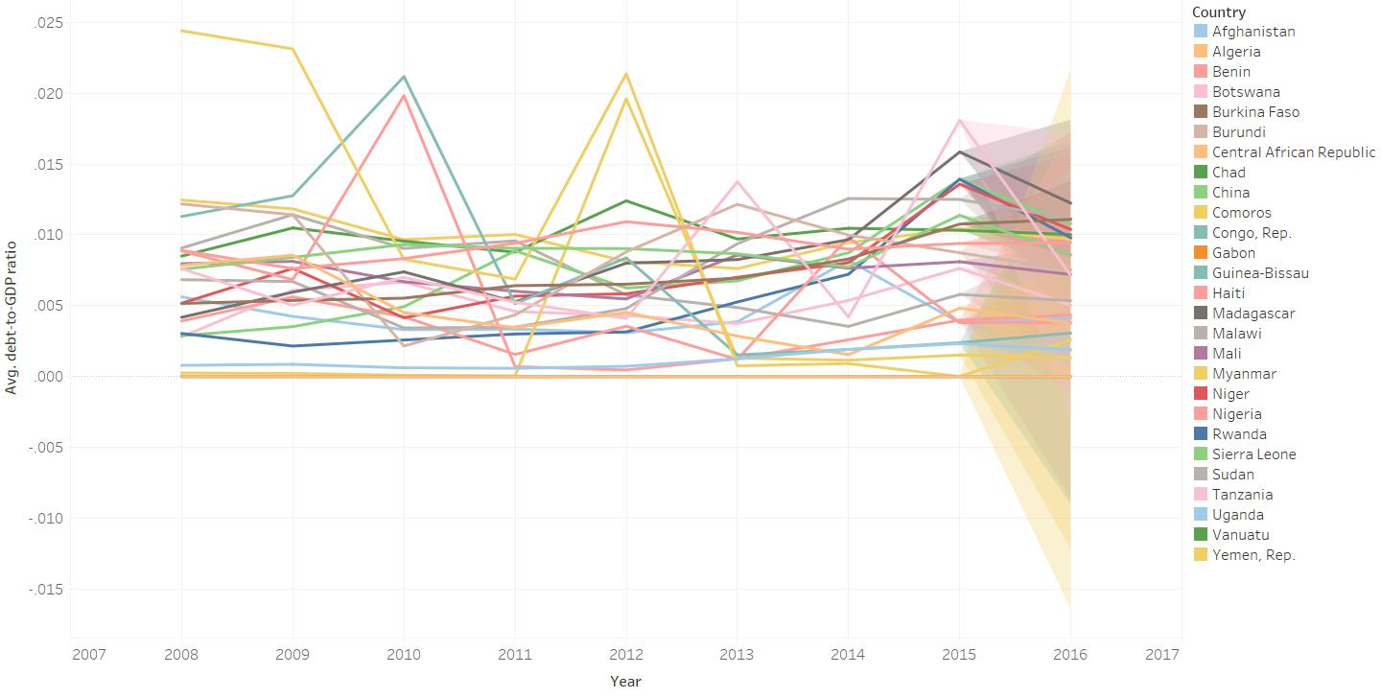
Figure 14: Trend of average debt-to-GDP ratio and prediction of 2016 (by Zihao Wang)
The line forecast chart shows the debt-to-GDP ratio of countries whose average debt-to-GDP ratios are lower than 0.01 from 2008 to 2015 and the estimated prediction value of 2016.
The chart depicts that most of the ratios fluctuates during the first years and have different degrees of decline in 2016.
The decrease of debt-to-GDP ratio indicates that an economy produces and sells more goods and services to have the ability to pay back debts, instead of having further debt.

Slide 16
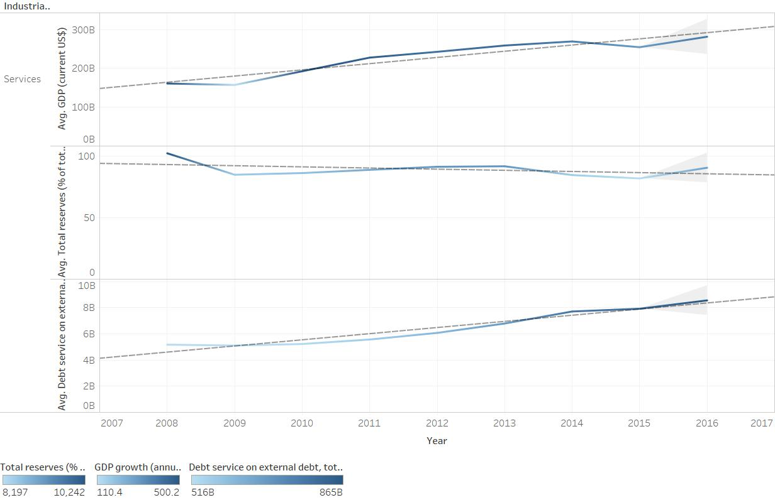
Figure 15: Forecasting GDP, Total reserves, and Debt service on external debt of service countries (by Haojunzhi Yu)
The Forecast plot uses 2008-2015 data of countries from Service industry (GDP, Total reserves, and Debt service on external debt) to predict 2016’s.
Total Reserves and Debt Services on external debt have lower forecasting data than actual data. Total Reserves has negative relationship with GDP, but Total Debt Service and Debt Service on external Debt has positive relationship with GDP.
Total Reserves is an important and valuable factors to study. Focus on the variation of Total Reserves on other countries’ situation is a reasonable direction.

Slide 17
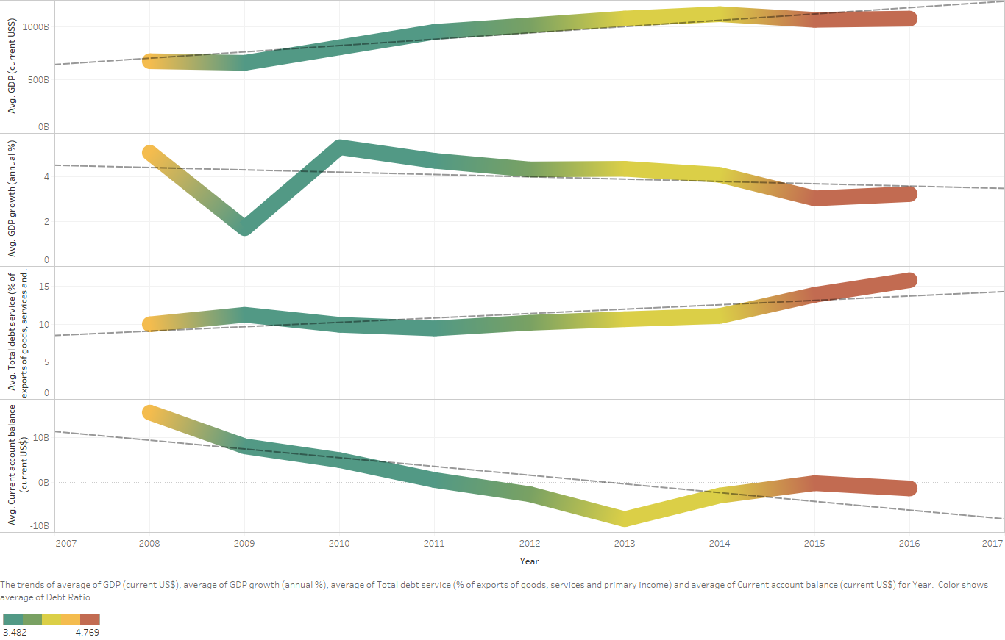
Figure 16 Trend Analysis among GDP, GDP Growth Rate, Total Debt Service and Current Account Balance with Average Debt Ratio (by Quanxu Pang)
This heat chart shows general trend lines as predictive analysis of all the developing countries’ GDP, GDP Growth Rate, Total Debt Service and Current Account Balance with Average Debt Ratio.
Insights from the chart are that all of the countries developed with growing Debt Ratio these years. Since their Current Account Balance and Total Debt Service gradually performed worse although their GDP looks good.
Implications would be an assumption that there is not any innovation that makes productivity greatly grown. The world economic development seems to go into a period of stagnation.

Slide 18
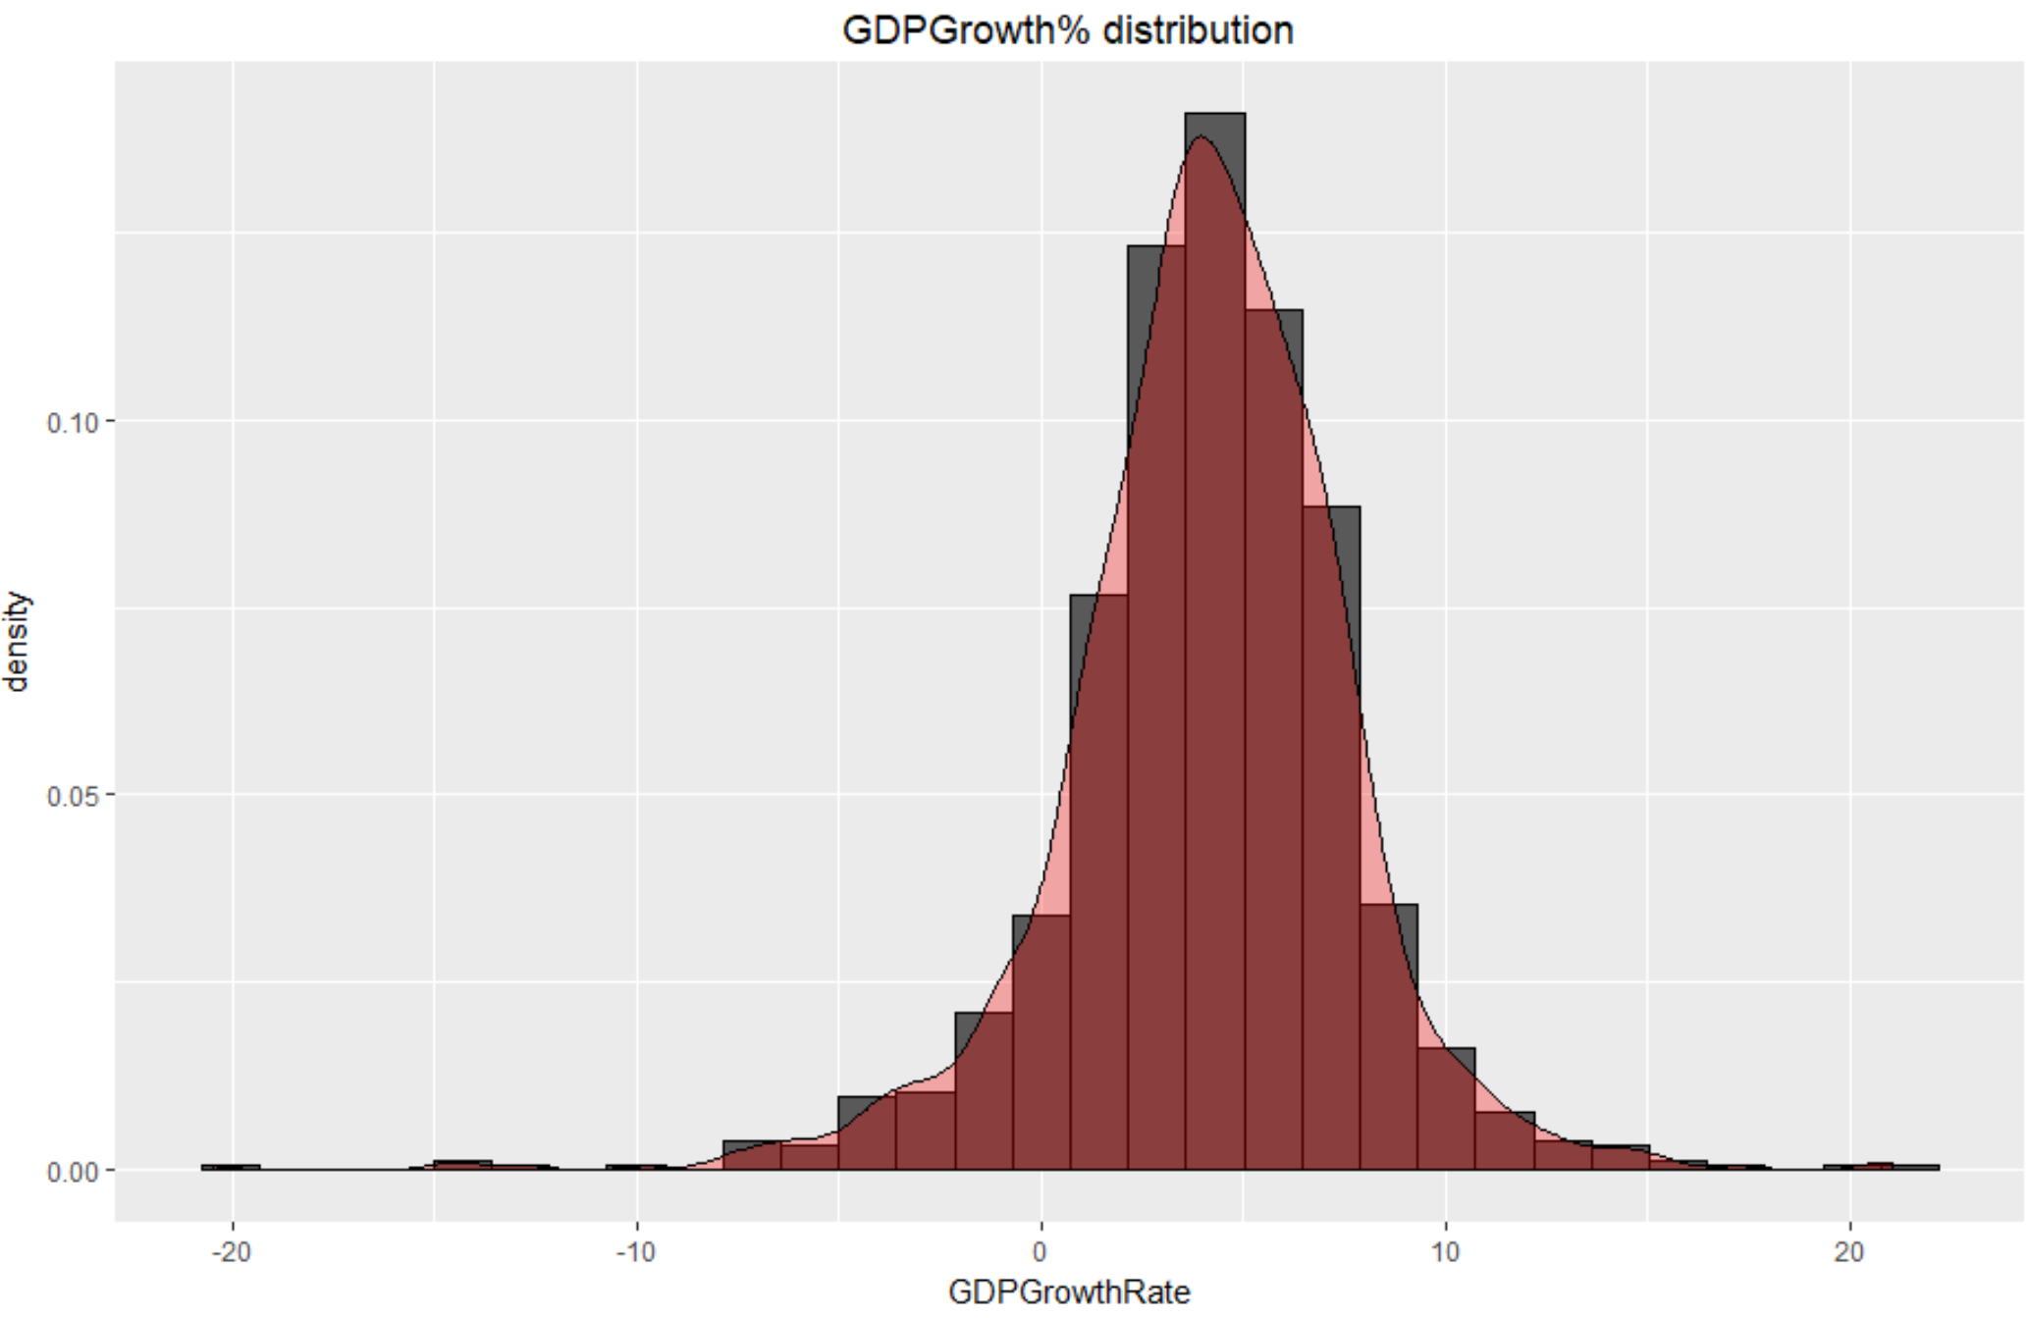
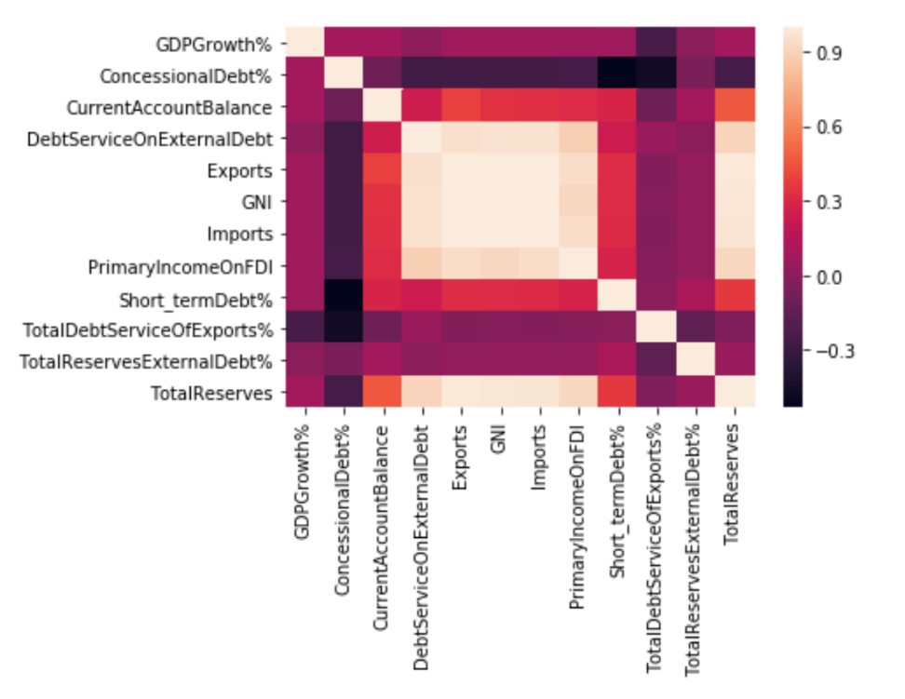
Statistical Model
Figure17: The distribution of GDP growth rate
Figure18: Heat map of the correlation of each variable
Figure 16 shows the distribution of GDP growth rate is a normal distribution which meets the assumption of Linear Regression.
Figure 17 is a heat map of correlation between each variable. We selected our variable base on the depth of color for avoiding collinearity.

Slide 19
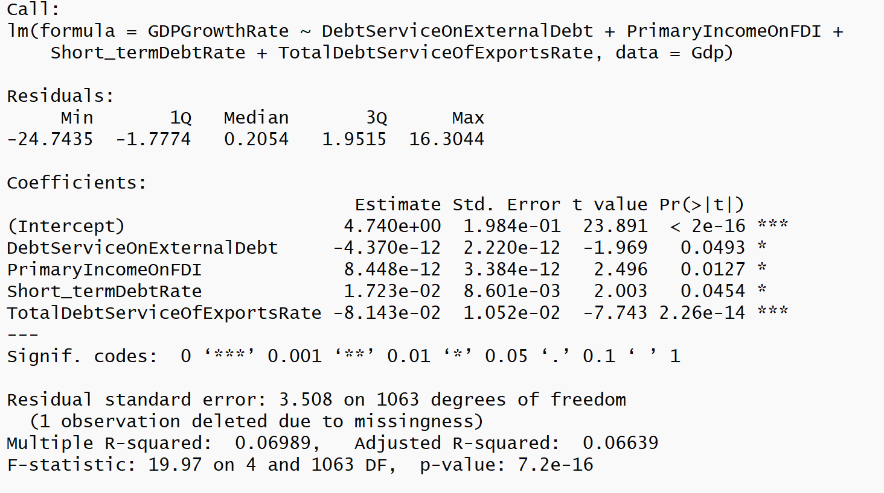
Figure 19: The results of our linear regression model
GDPGrowthRate = 4.74 – 4.37e-12Debt Service On External Debt + 8.448e-12 PrimaryIncomeOnFDI + 1.723e-02 Short_termDebtRate – 8.143e-02 Total Debt Service of ExportsRate
Total debt service% is the most crucial factor in our linear regression model, which confirms the correctness of descriptive analytics in Figure 4 and Figure 5
The p-value of our linear regression model is 7.2e-16, which is extremely low. However, the adjusted R-squared is only 0.066 which means our model could only explain 6.6% dependent variables in our dataset.
In conclusion, our model shows these four variables, debt service on external debt, primary income, short-term debt rate and debt service% do have a significant influence on describing GDP growth rate. But we need to add more variables to improve our model’s efficiency.

Slide 20
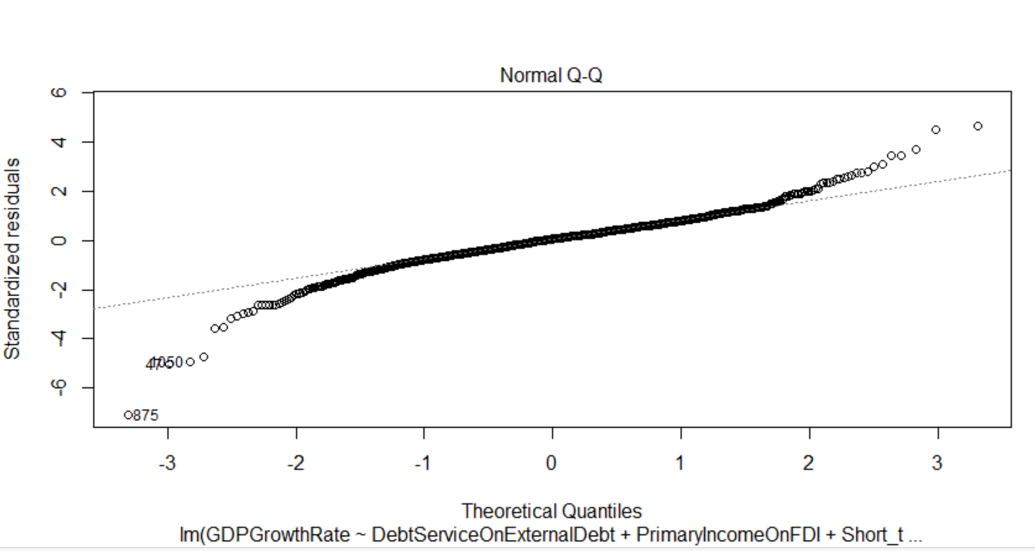
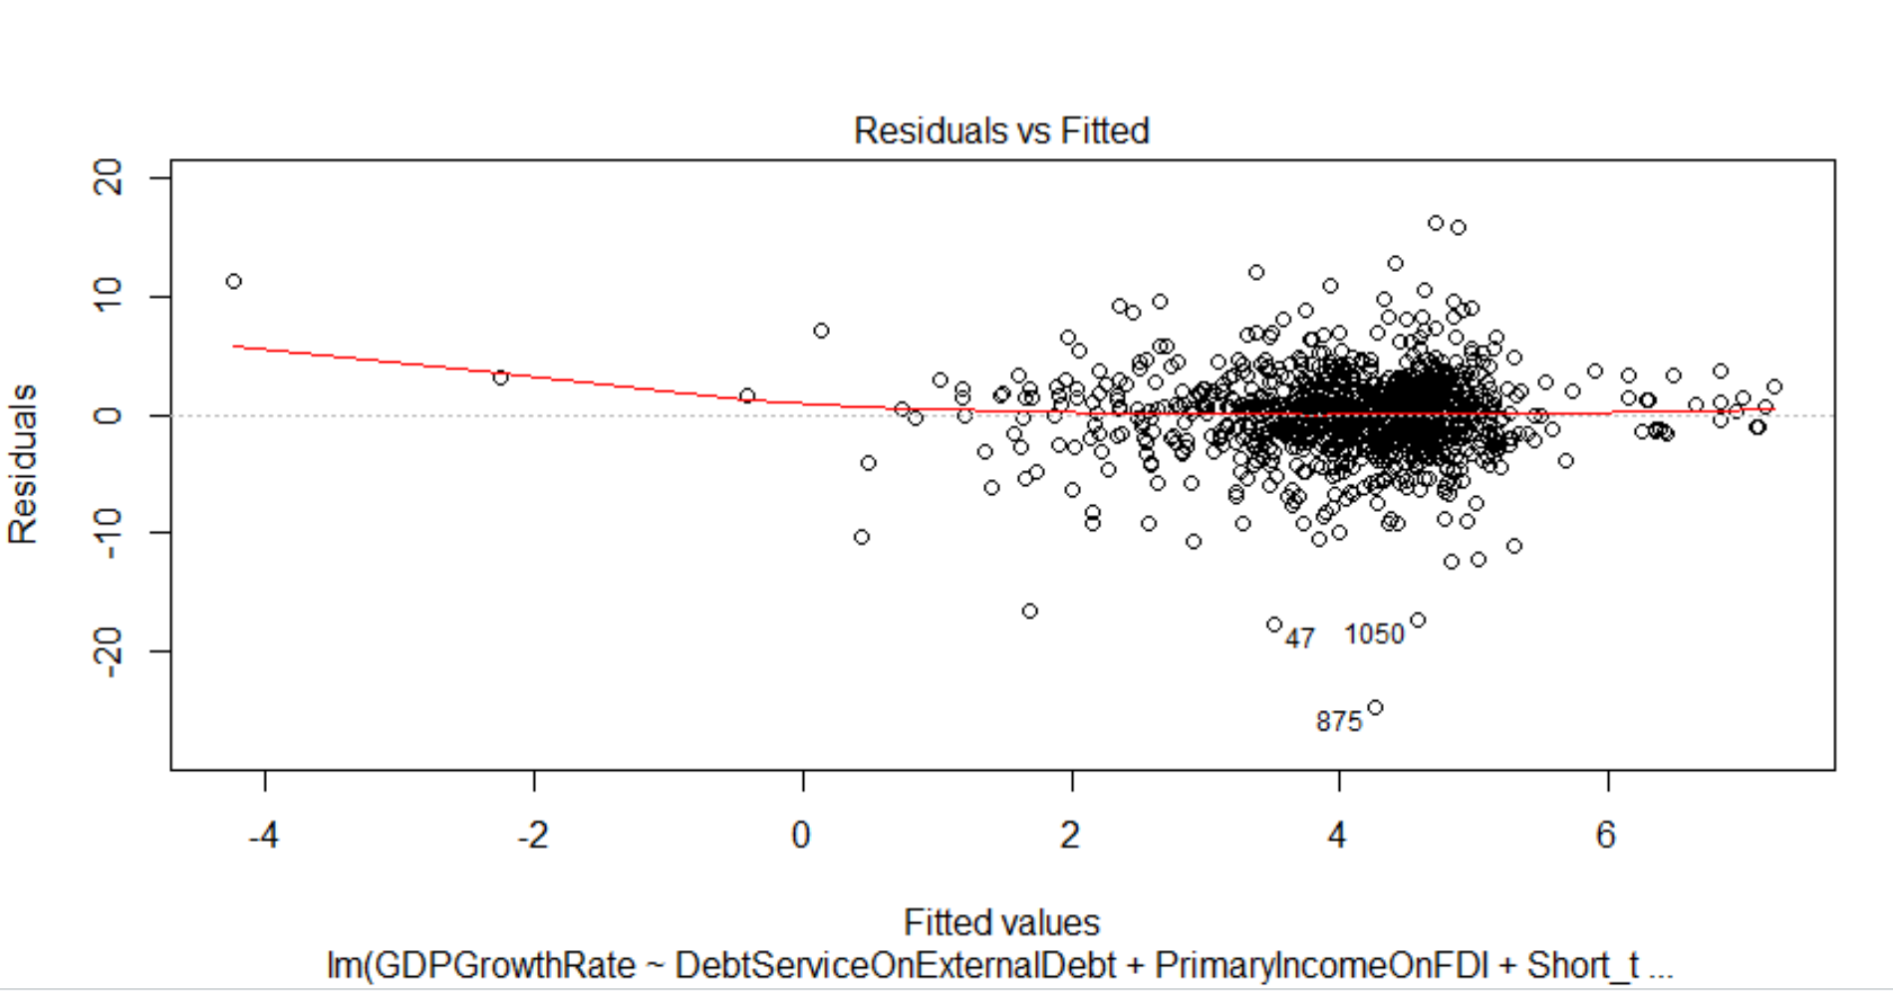
Figure 20: Residuals vs Fitted
Figure 21: The Normal Q-Q plots
The line in od Residuals and Fitted of Figure 19 is about straight, which means the model satisfies the assumption of linear regression.
In Figure 20 Normal Q-Q plots construct a straight line, so dependent variables are also belong to normal distribution.
Based on the figures above, our linear regression model is proved to be scientific, rigorous and valid

Slide 21
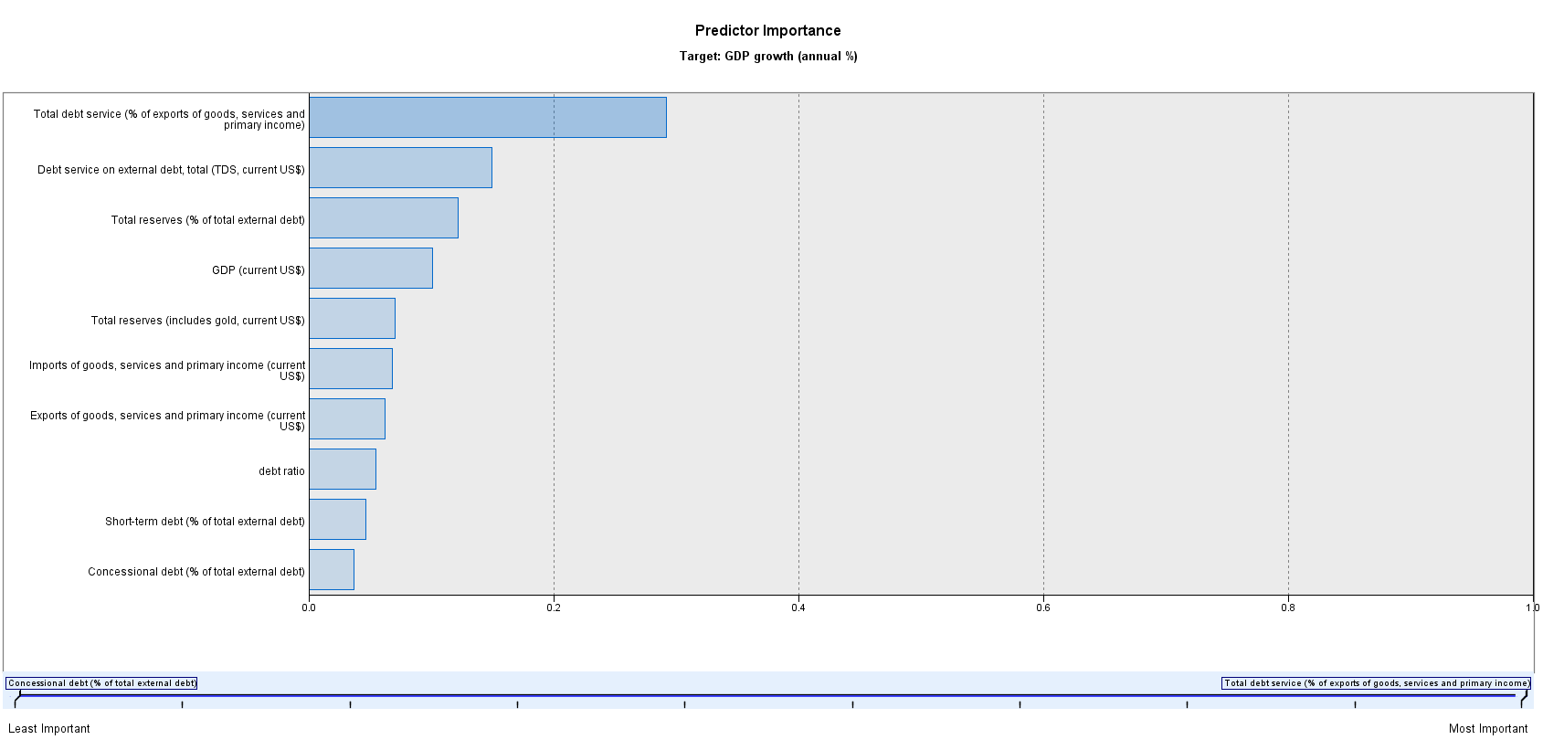
Figure 22: Neural Network for GDP Growth Rate
Machine Learning Model
Predicting accuracy of the accomplished model is only 8 percent which refers to an underfitting model.
Not enough data is used to train the model, however predictor importance is still useful for explaining.
According to the predictor importance, although debt ratio doesn’t show reliability, total debt service still occupies 1st position effect.

Slide 22
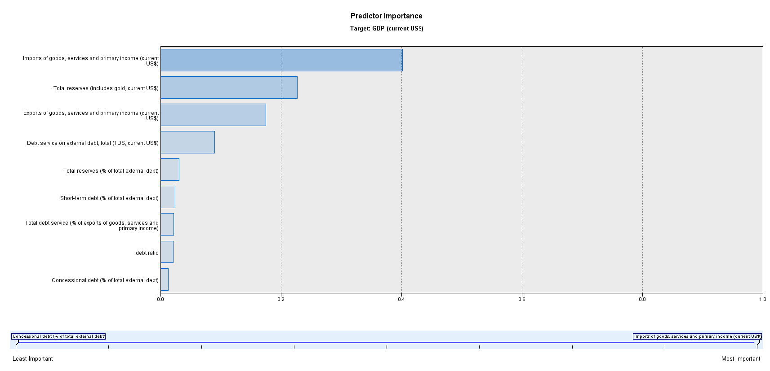
Figure 23: Neural Network for GDP
This model is an overfitting model with more than 96 percent predicting accuracy.
According to the predictor importance, debt ratio also doesn’t show a significant impact.
Comparing to these two models, government is supposed to pay more attention to debt data and adjust their fiscal policies.

